Slide 1


Slide 2

TALLINN
HEALTH CARE
COLLEGE
2018

Slide 3
Contents
1
2
3
4
5
6
7
8
Tallinn Health Care College
Structure
Mission and Vision
Core Values
Important Dates
Accreditations and External Evaluations
Programmes of Higher Education
Programmes of Vocational Education
9
10
11
12
13
14
15
16
Structural Unit in Kohtla-Järve
Pärnu Hospital
Practical Training
Study Rooms and Laboratories
International Cooperation
Student Council
Student Hostel
Library

Slide 4
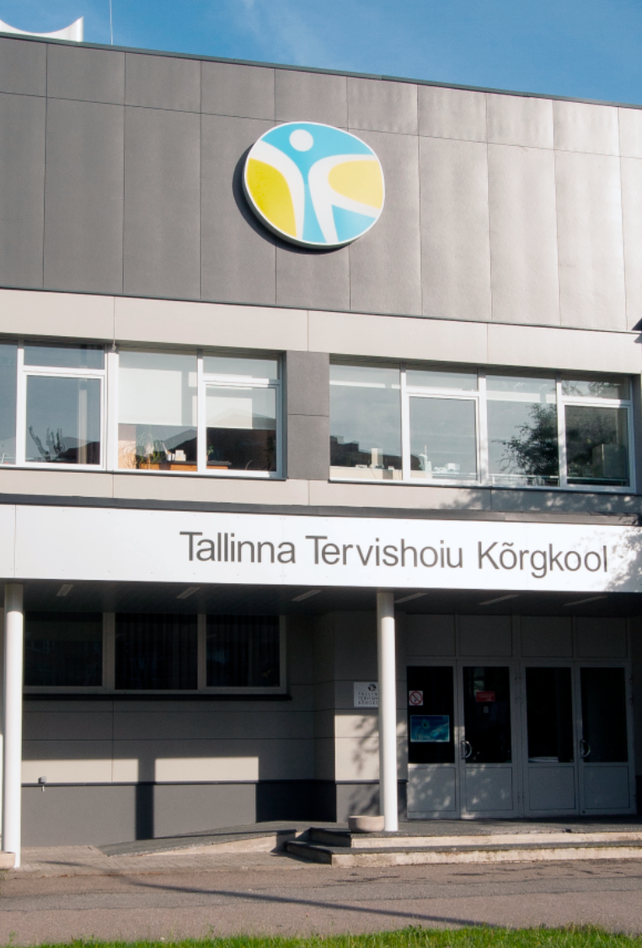
Tallinn Health Care College
Internationally recognized state professional higher education institution offering training in the field of health and well-being
One of the two health care colleges in Estonia
In Tallinn and in Kohtla-Järve
Possibility of performing studies in other regional units
Rector since 2001 - Ülle Ernits
In 2018 the college has approximately 1900 students (Master’s level - 60, higher education - 1464, vocational education - 433) and 140 employees

Slide 5
Mission and Vision
Mission
The College trains innovatively and critically thinking health professionals with technological competences.
Vision
The College is in continuous development, nationally and internationally networked organisation, where, in collaboration with national and international partners and involving the learners, current challenges are addressed.

Slide 6
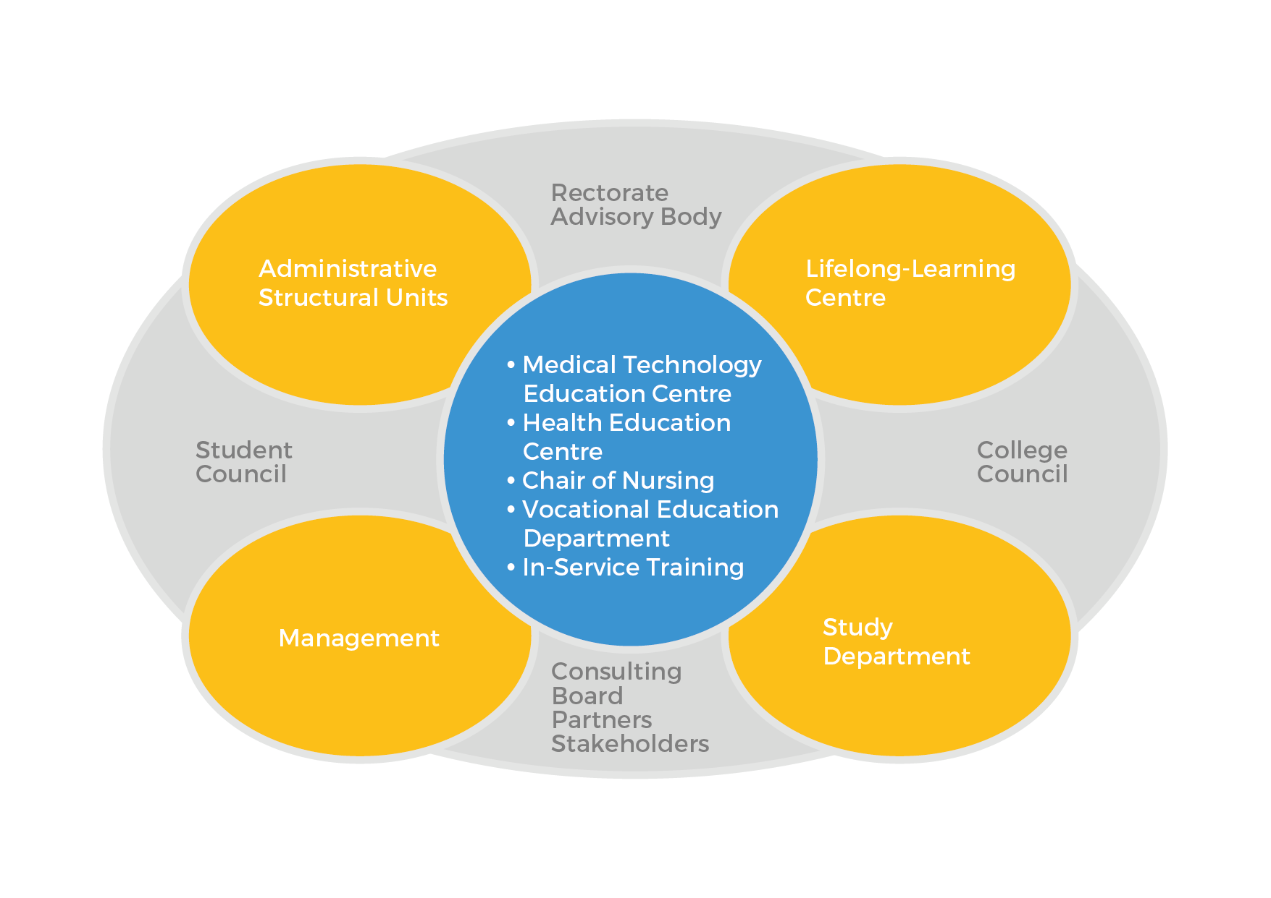
Structure

Slide 7

Core Values
PEOPLE INIMENE
COOPERATION KOOSTÖÖ
INCLUSION KAASAMINE
DEVELOPMENT ARENG

Slide 8
Important Dates
1940 – Tallinn Medical School was founded
2002 – Nursing education studies (for nurses with previous vocational education) started in Kohtla-Järve Medical School
2005 – Tallinn Medical School became a higher education institution and was renamed Tallinn Health Care College
2006 – Kohtla-Järve Medical School became a structural unit of Tallinn Health Care College
2007 – studies started in Pärnu Hospital
October, 16 – anniversary of Tallinn Health Care College

Slide 9
Accreditations and External Evaluations
2012 – Institutional Accreditation
The Quality Assessment Council of the Estonian Higher Education Quality Agency decided to accredit Tallinn Health Care College for 7 years.
2015 – Accreditation of Vocational Education
The Quality Assessment Council of the Estonian Higher and Vocational Education Quality Agency decided to accredit Tallinn Health Care College health and social services curriculum for 6 years.
2016 – Quality Assesment
The Quality Assessment Council for Higher Education of the Estonian Quality Agency for Higher Education and VET decided to approve the report by the Assessment Committee and to conduct the next quality assessment of the Medicine study programme group in the first cycle of higher education in 7 years, and of the Health Care study programme group in the first cycle of higher education at Tallinn Health Care College in 7 years, with a secondary condition.

Slide 10
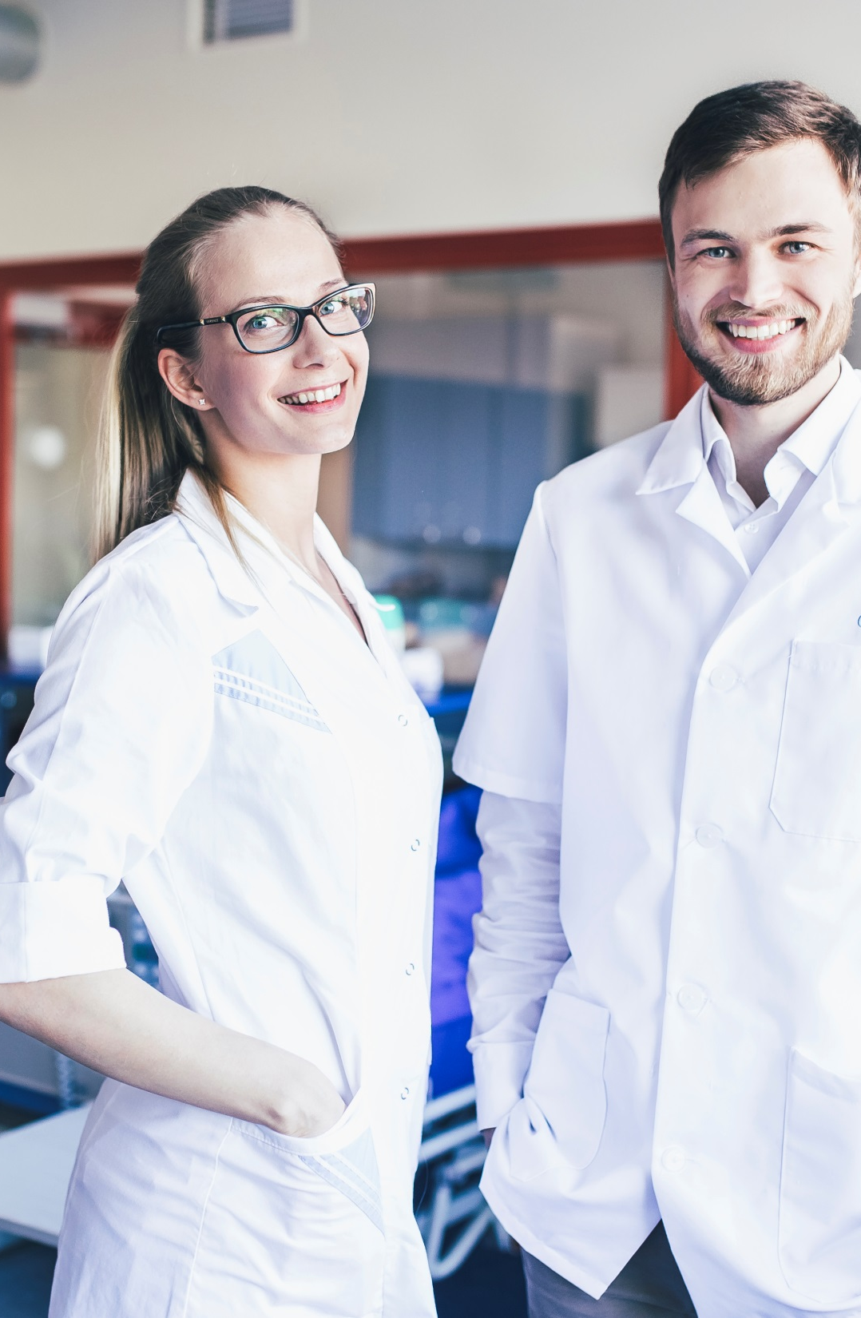
Master’s, Programmes of Higher Education
Health Sciences Master’s Degree – 1,5 years
General Nurse – 3,5 years
Midwife– 4,5 years
Optometrist – 3,5 years
Assistant Pharmacist – 3 years
Dental Technician – 3,5 years
Occupational Therapist – 4 years
Health Promotion – 3 years

Slide 11
Programmes of Vocational Education
Care Worker – 2 years
Emergency Medical Technician – 1 year
Childminder – 1 year
Assistive Technology Specialist – 1 year, workplace-based learning
Client Worker for People with Mental Health Problems – 1 year, workplace-based learning
Sterilisation Techinician – 1 year, workplace-based learning

Slide 12
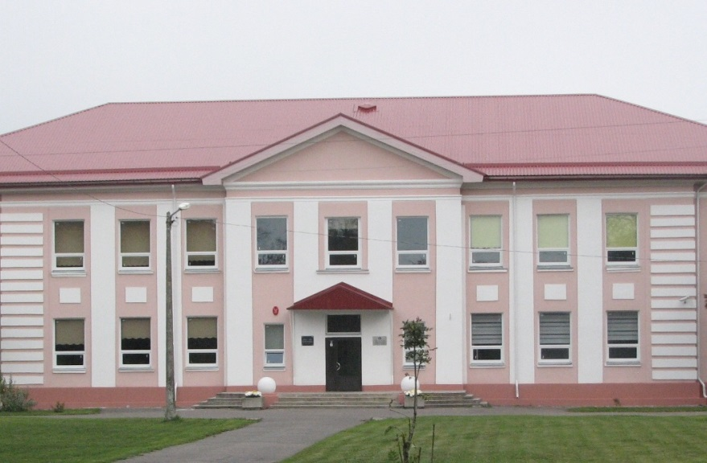
Structural Unit in Kohtla-Järve
Programmes taught in Kohtla-Järve:
- General Nurse
- Care Worker

Slide 13

Pärnu Hospital
Nursing studies in Pärnu Hospital started in 2007 – firstly for nurses with previous vocational education
In 2014 Tallinn Health Care College, Pärnu Hospital, Estonian Nurses Union and Pärnu College signed a joint project titled “College in the Hospital”
Aim of the project: to provide the possibility to study nursing in higher education close to home
First study group started in 2014 – 31 students
Second and third study groups started in 2017 and 2018 – 30 students + 30 students

Slide 14

Practical Training
Practical training forms 30-50% of the studies
Wide network of practical placements all over Estonia
Individual support is provided by the mentor at the practical placement, supervisor at the college and the tutor student

Slide 15
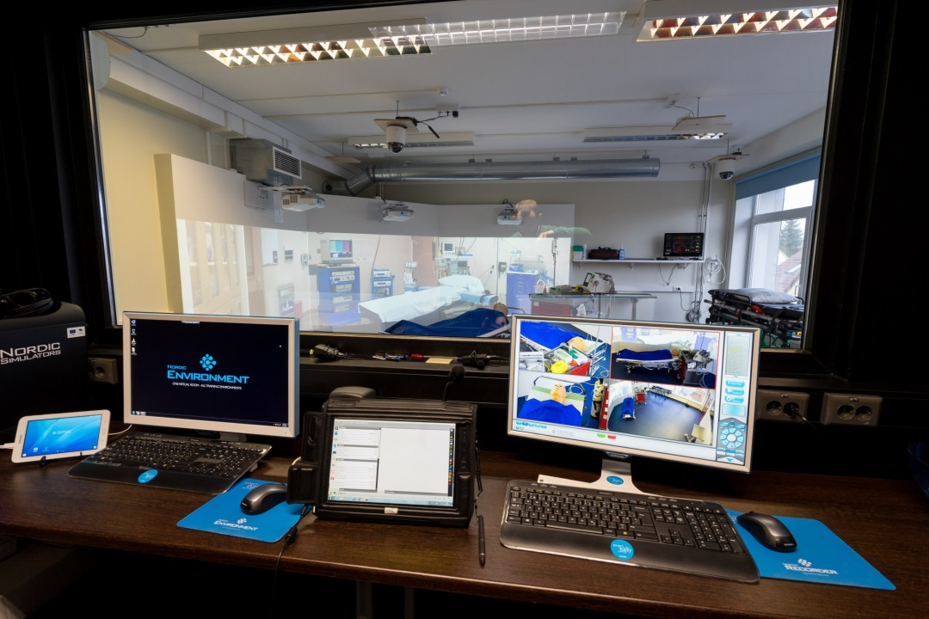
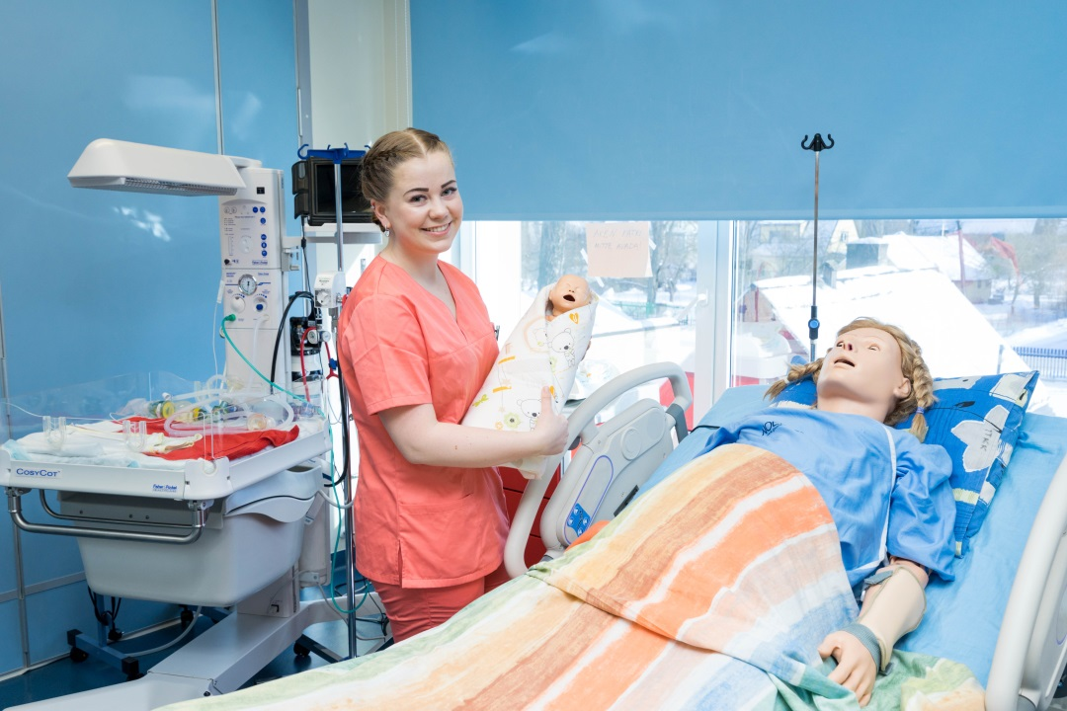
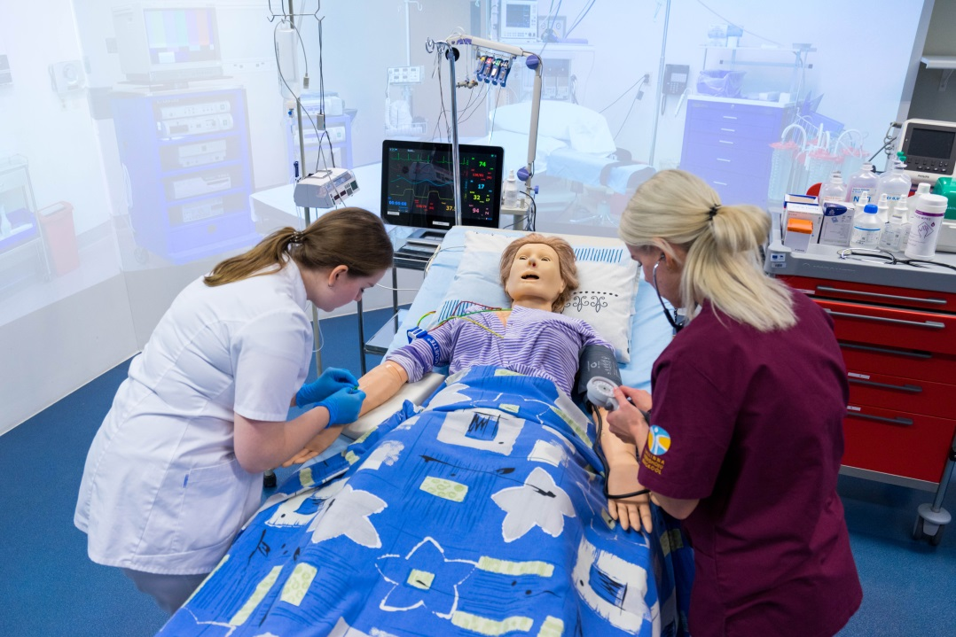
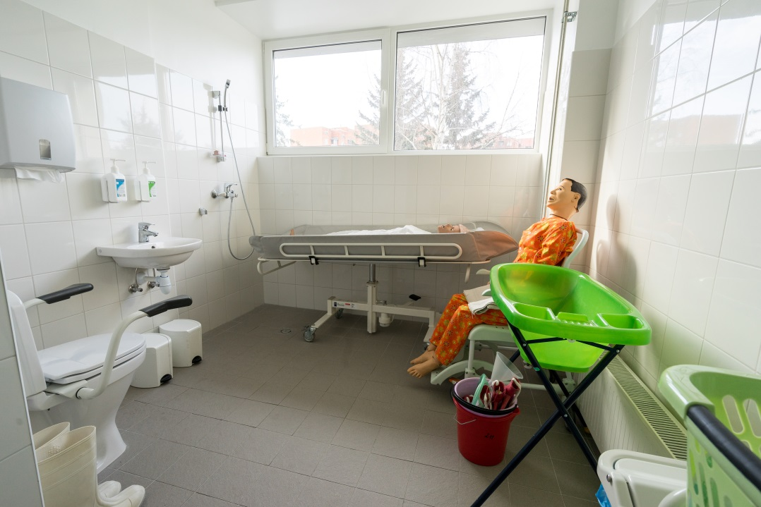
Simulation Center

Slide 16
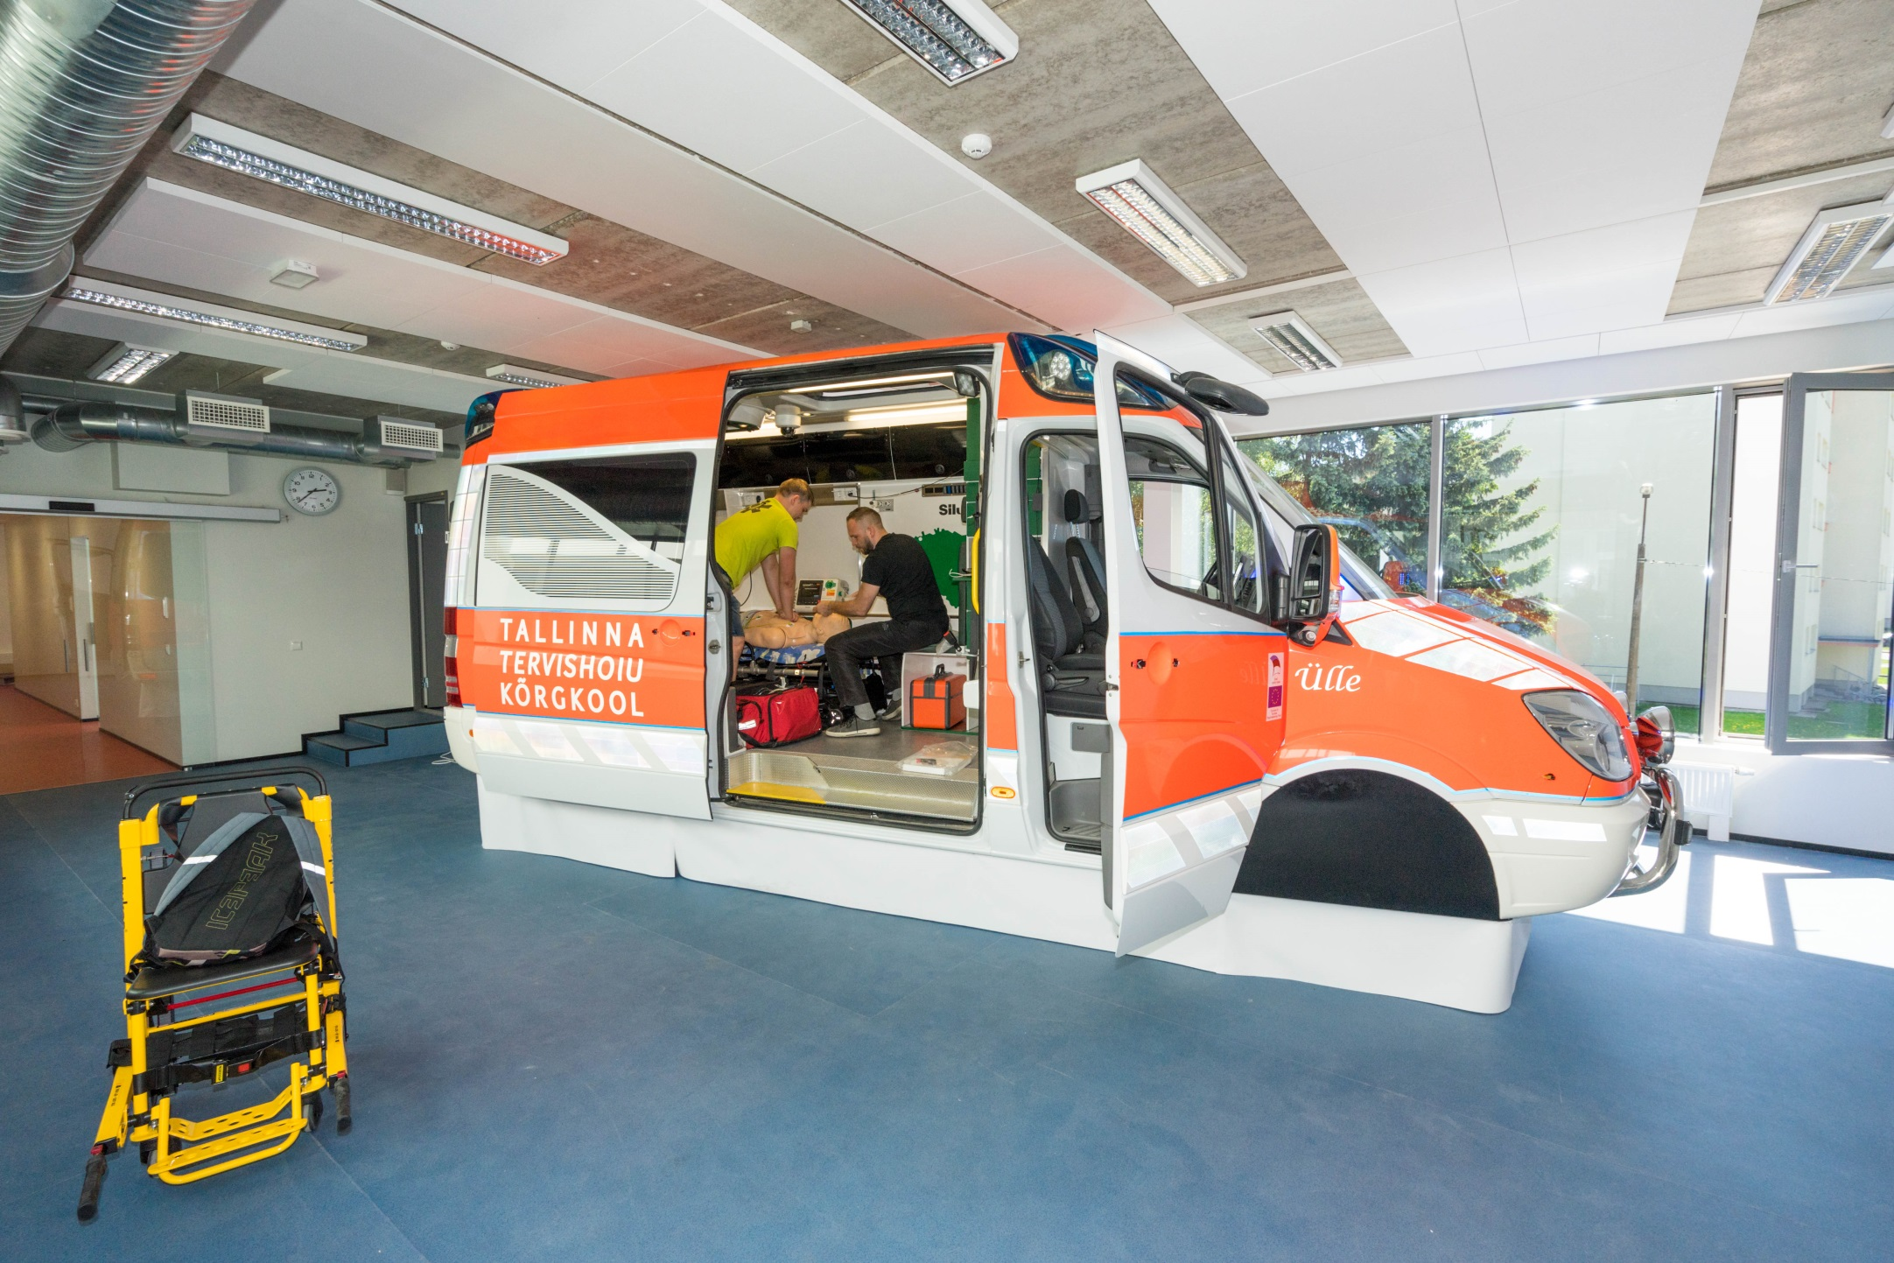
Ambulance Car Simulator

Slide 17
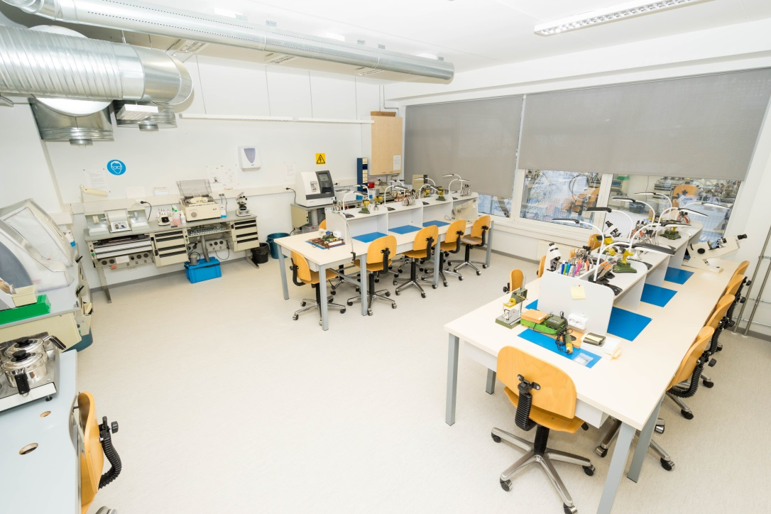
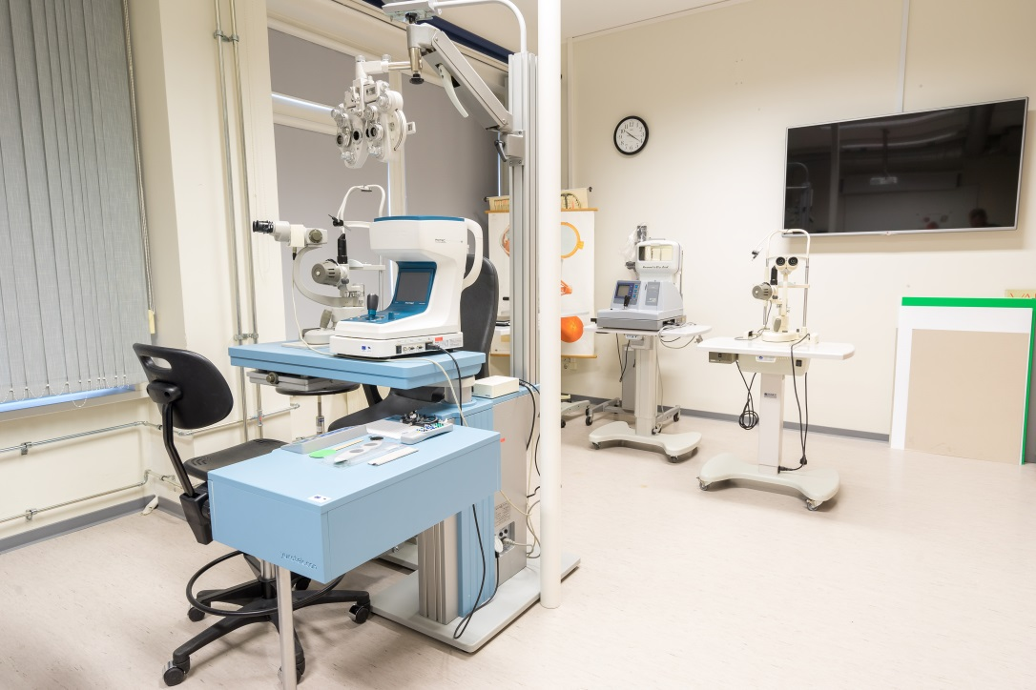
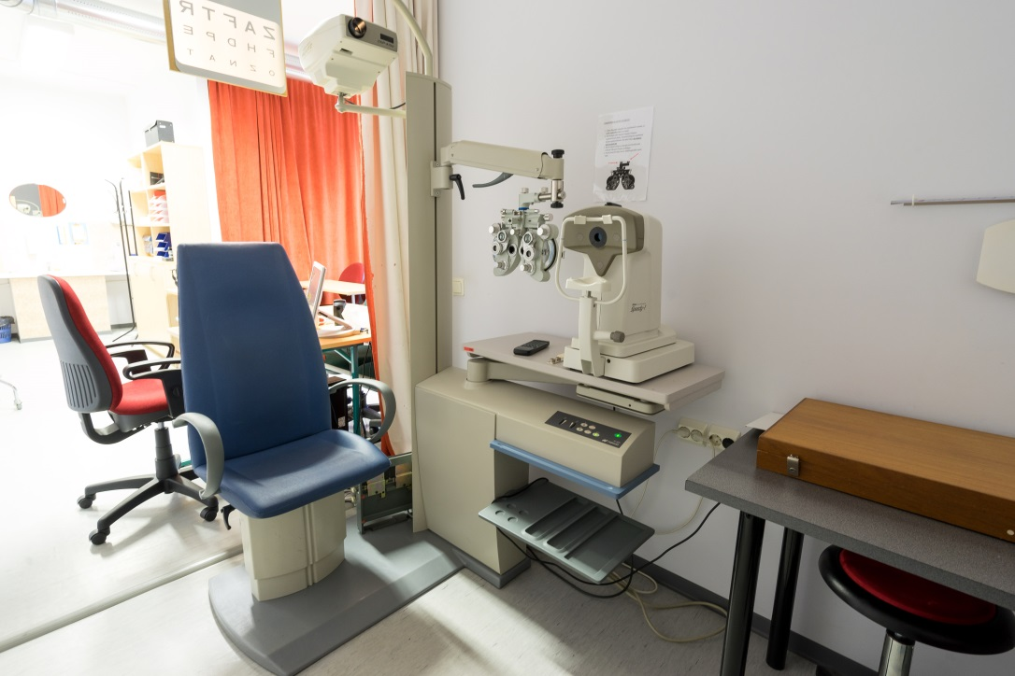
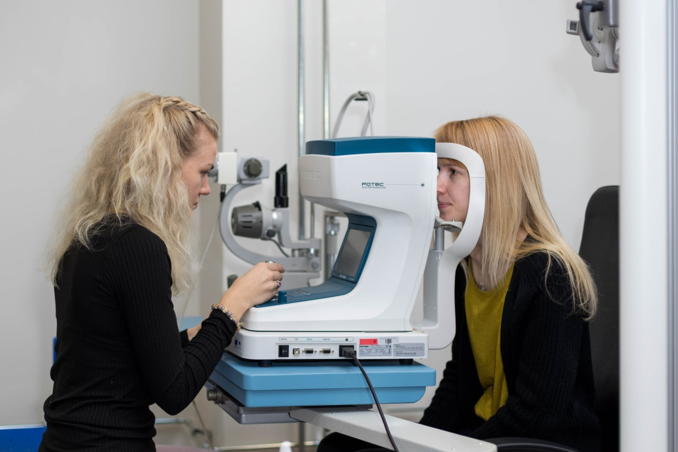
Optometry Laboratories

Slide 18
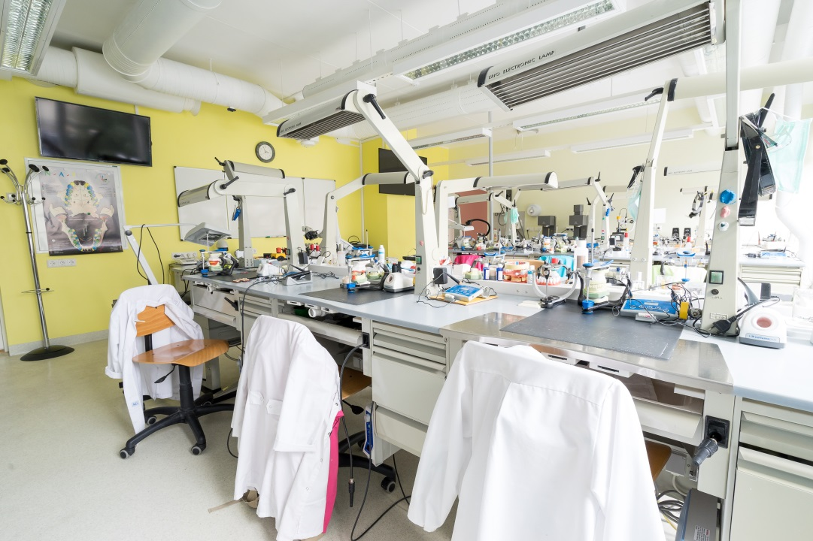
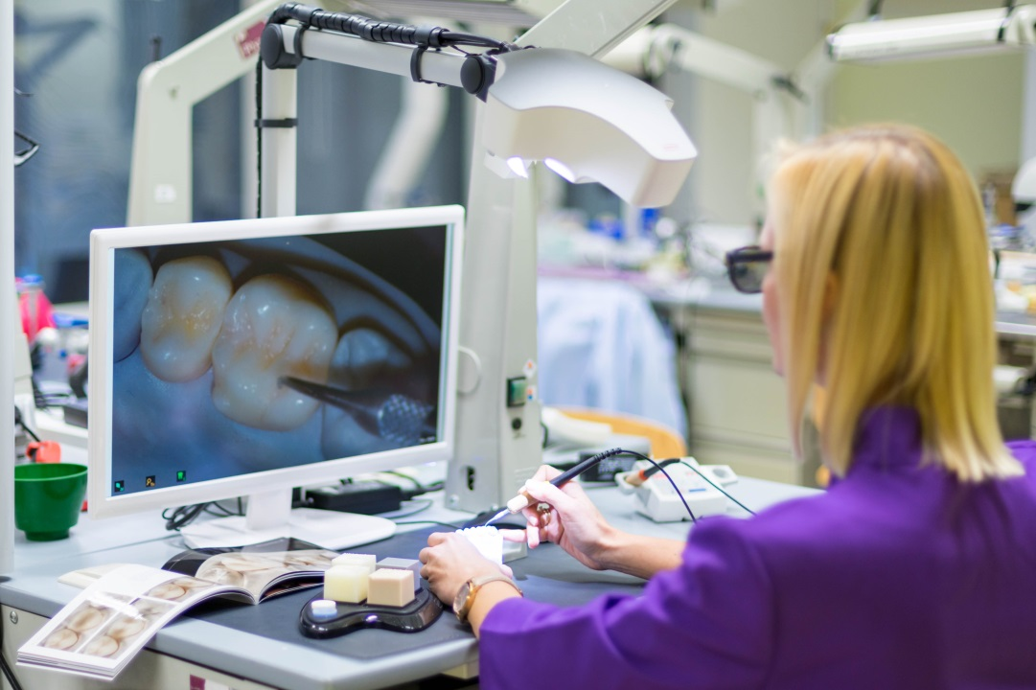
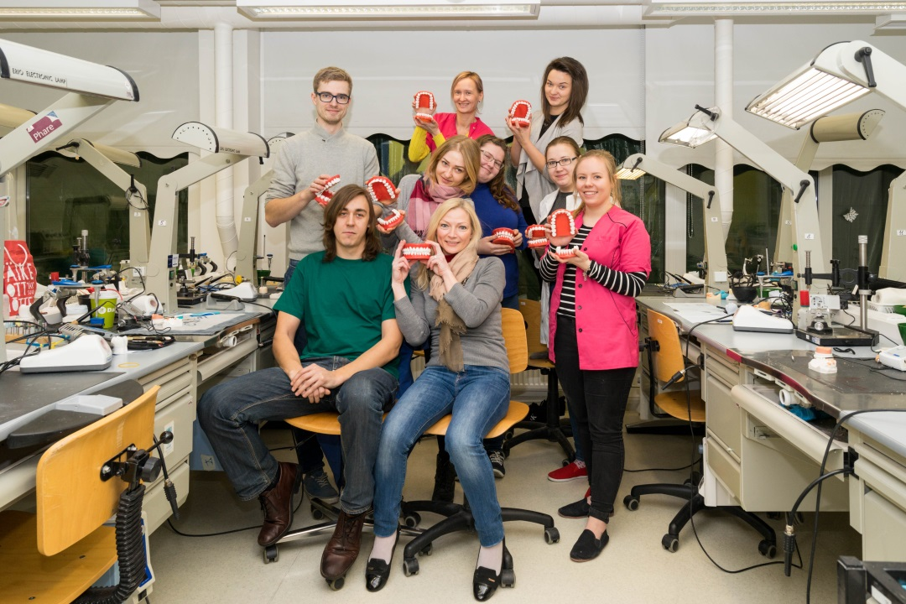
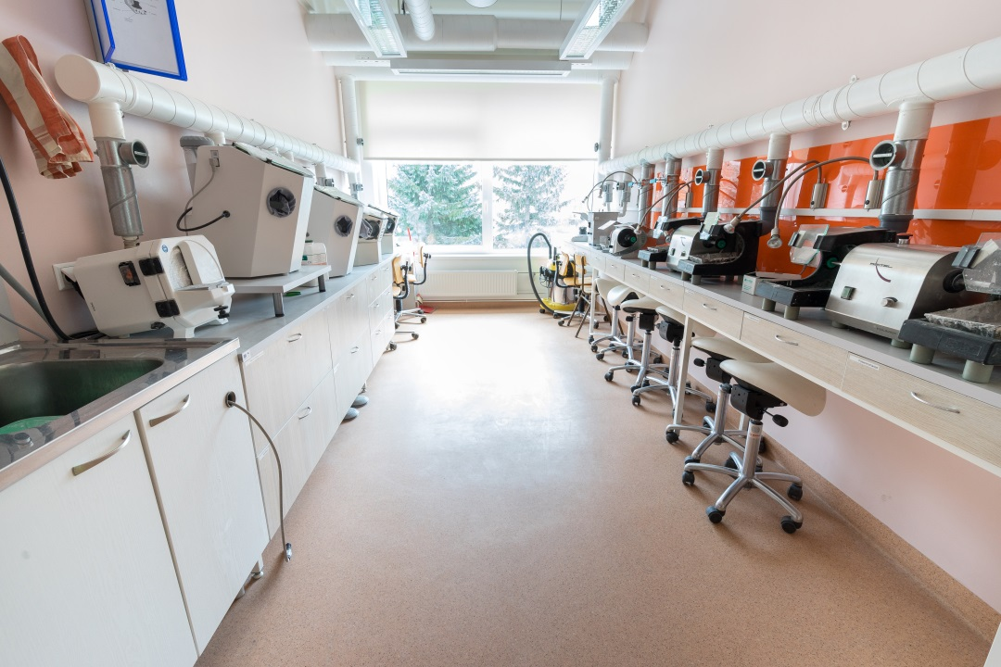
Dental Technocology Laboratories

Slide 19
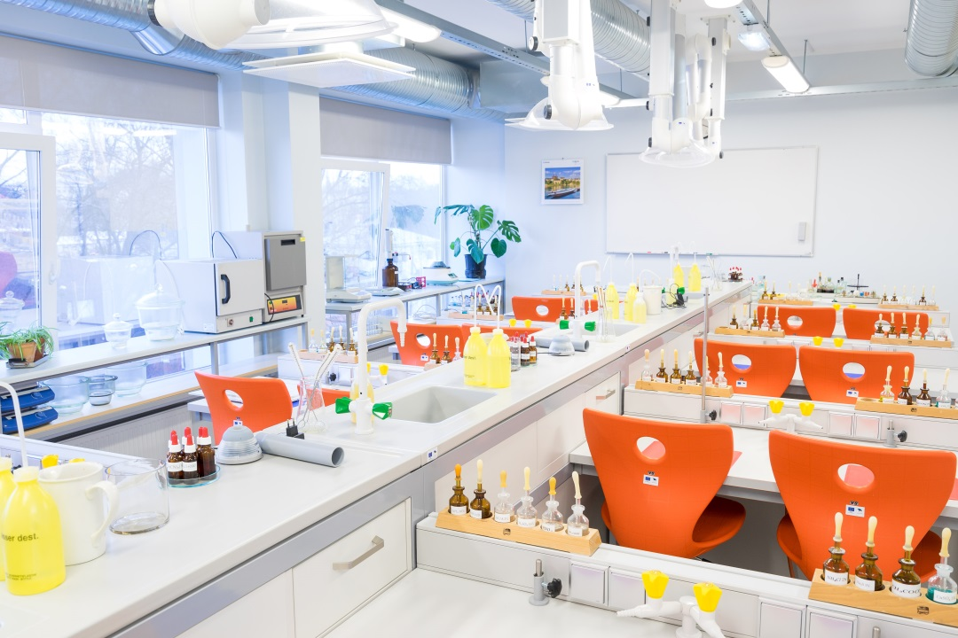

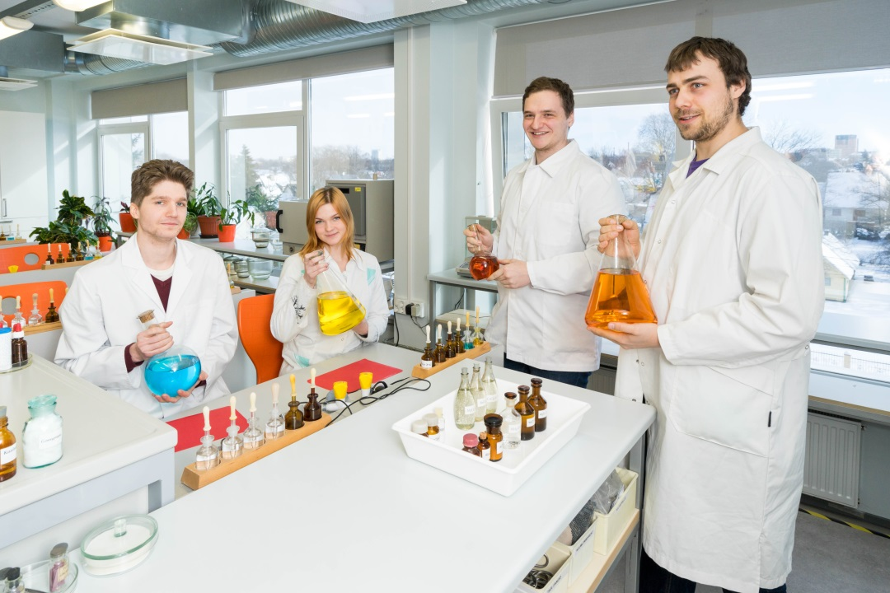
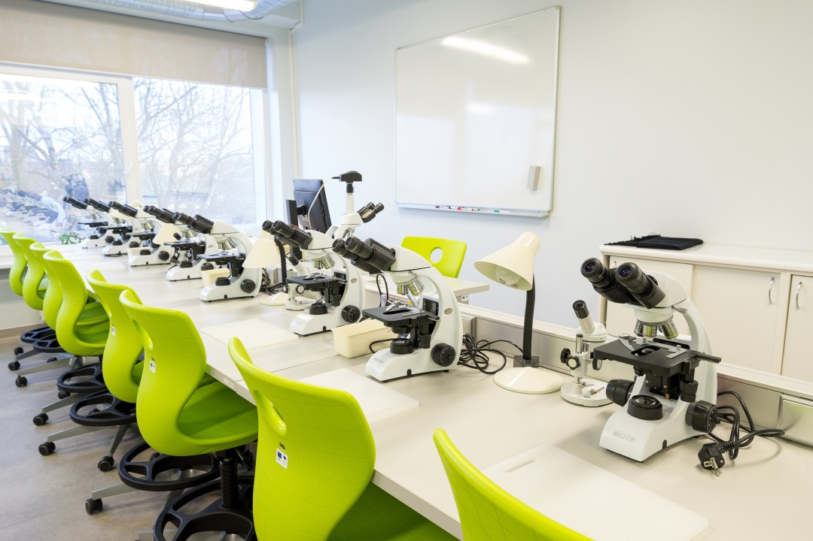
Pharmacy Laboratories

Slide 20
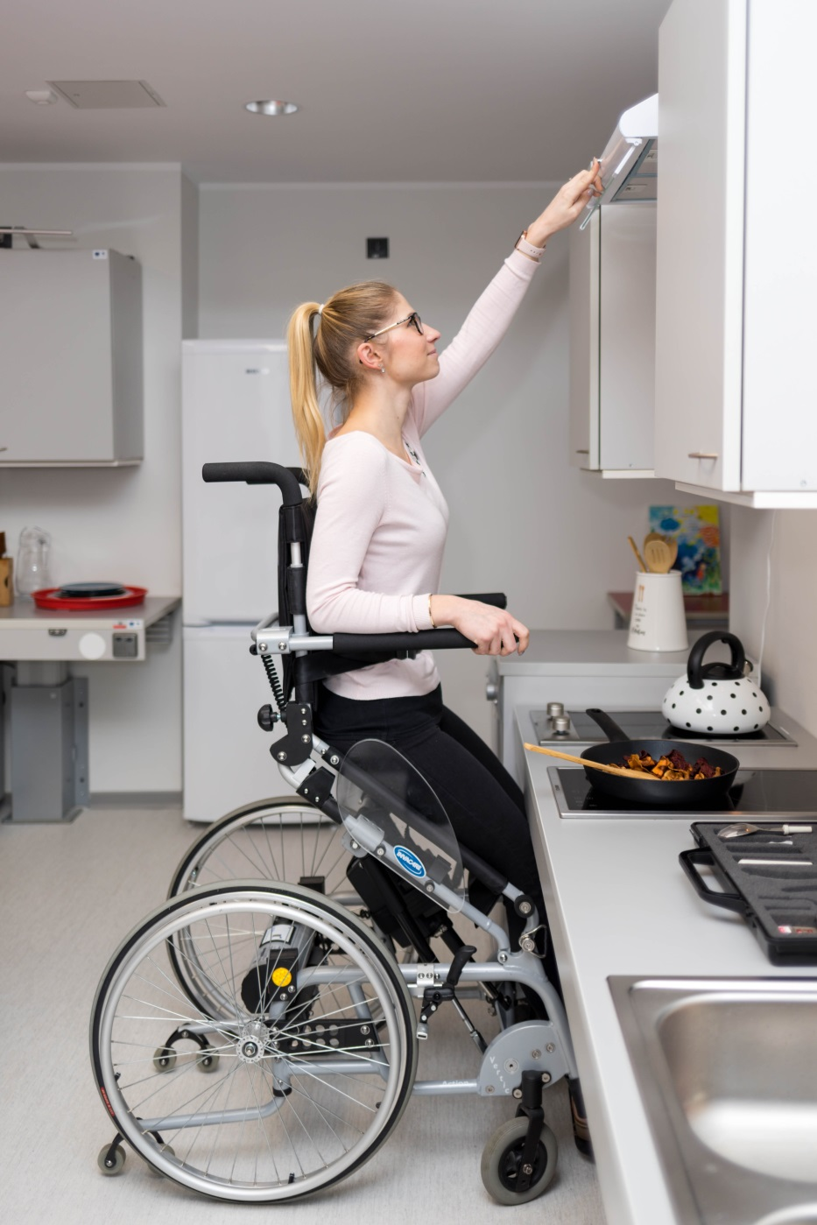
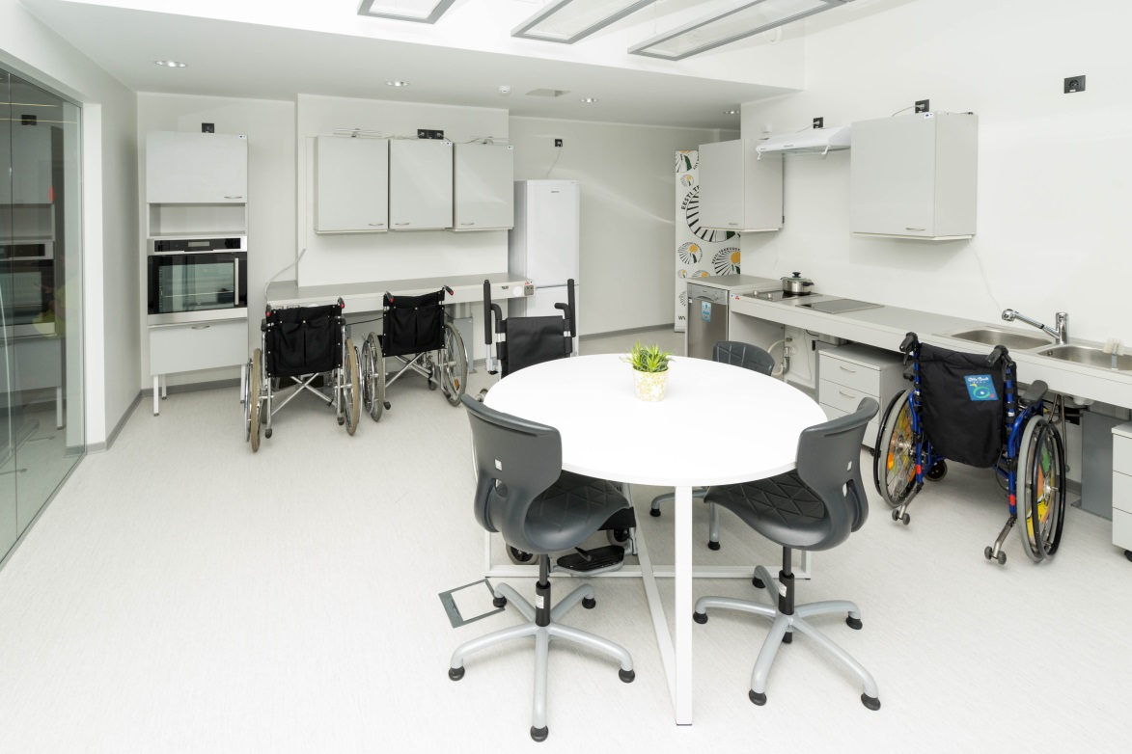
Occupational Therapy Learning Apartment

Slide 21
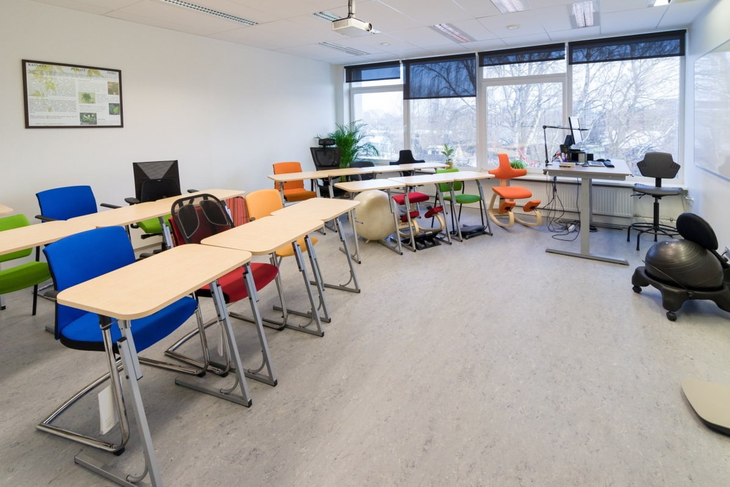
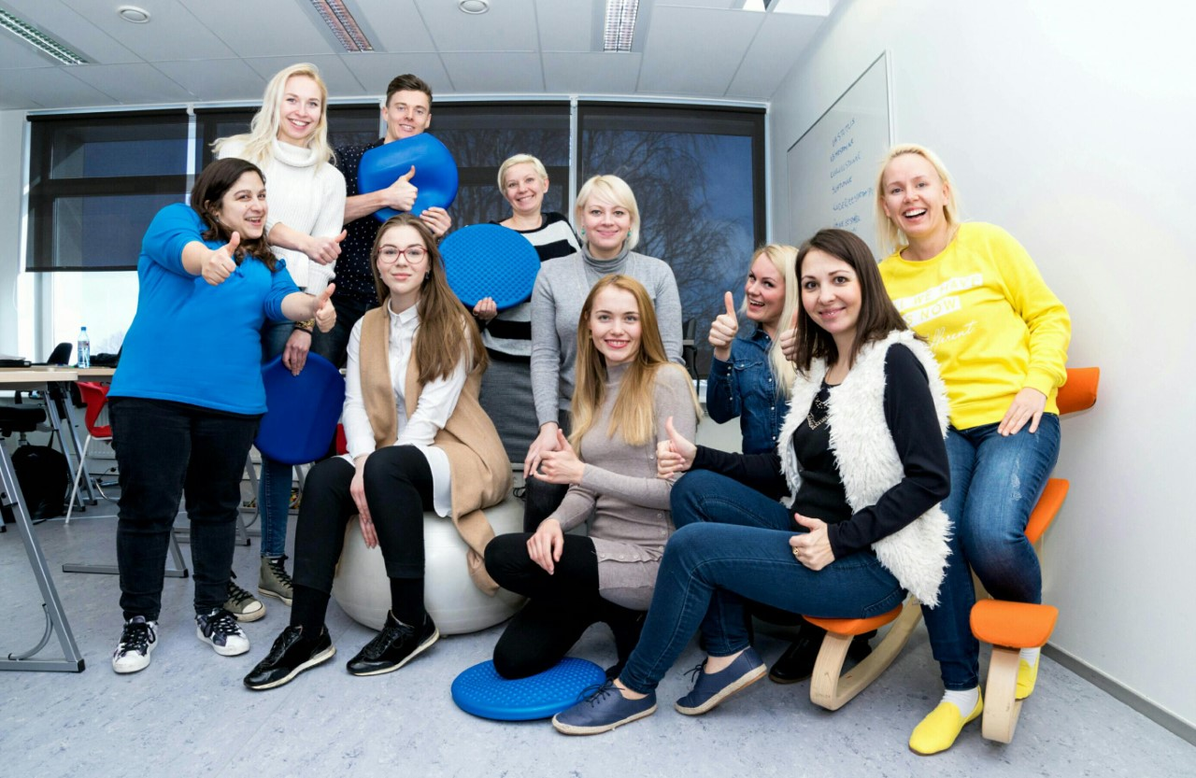
Ergonomic Classroom

Slide 22
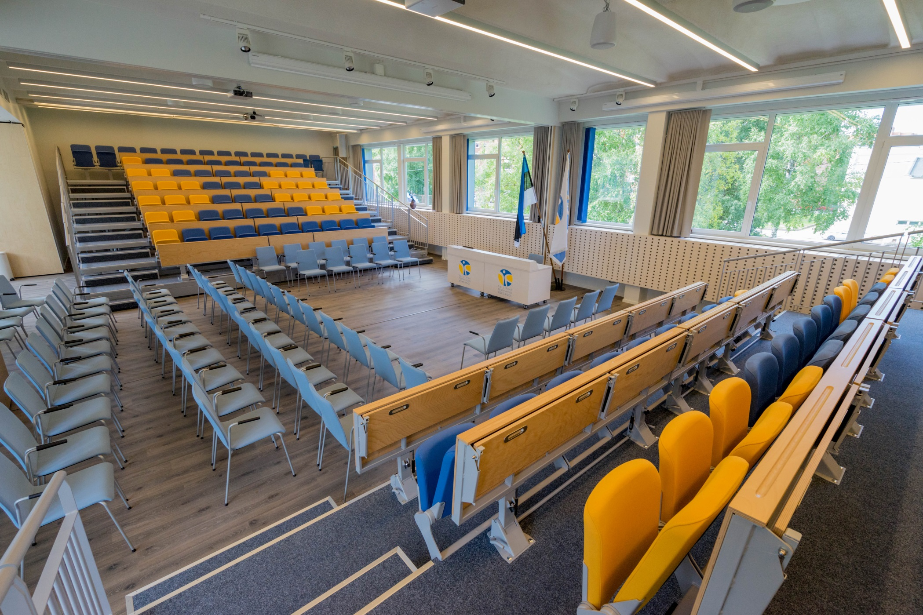
Assembly Hall

Slide 23
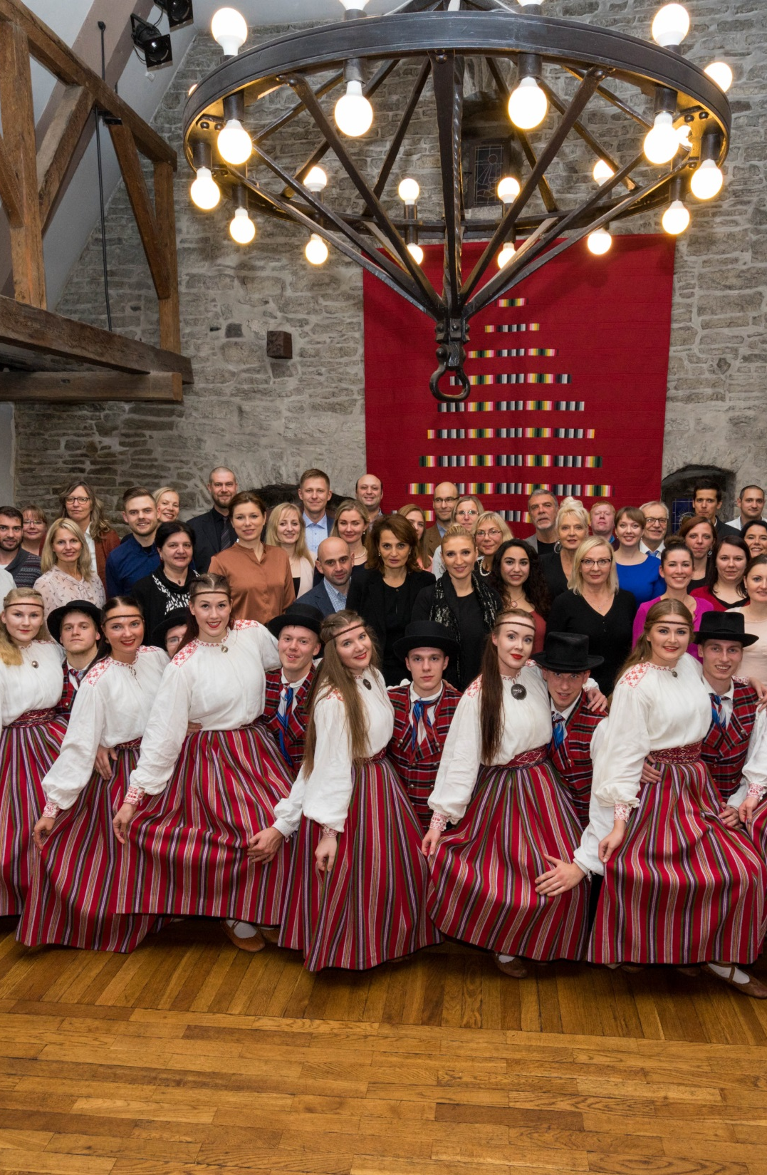



International Cooperation
First week of November – International Week
Erasmus+
Erasmus+ credit mobility
Nordplus
EEA/Norway scholarship programme
Bilateral agreements

Slide 24
Incoming: students and staff mobility

Slide 25
Outgoing: students and staff mobility

Slide 26
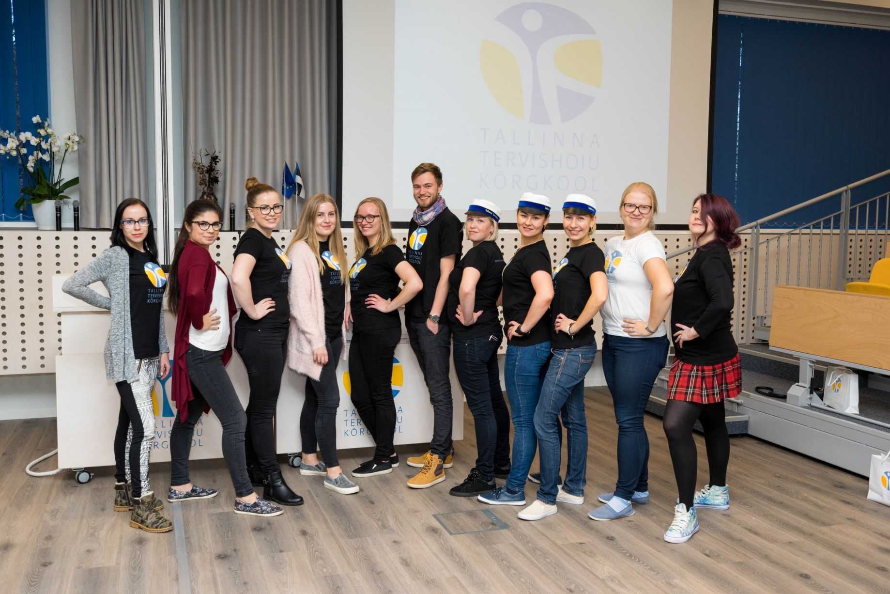
Student Council
Has been active since 1995

Slide 27
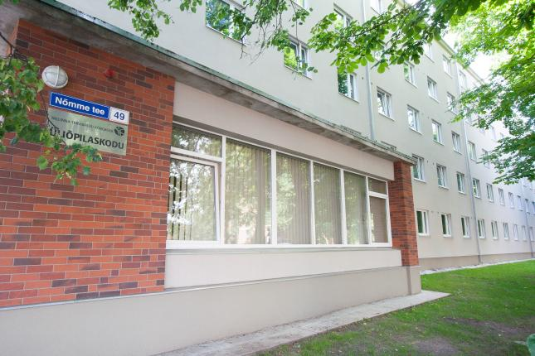
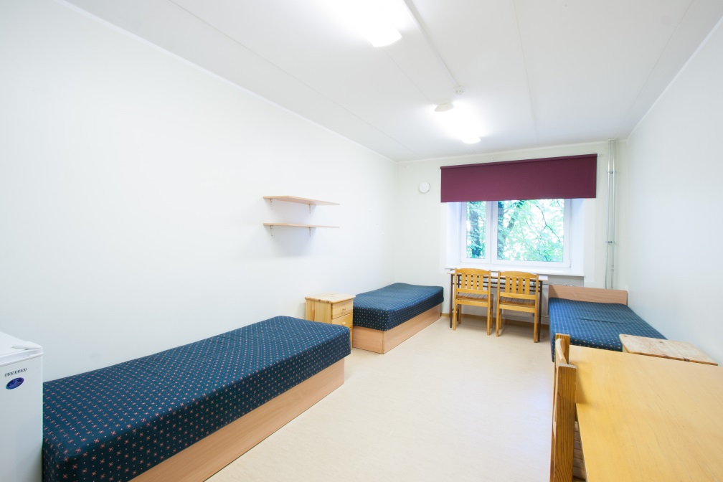
Student Hostel
Accommodates up to 250 students
Reasonable prices
Virtual tour:
www.ttk.ee/virtuaaltuur

Slide 28
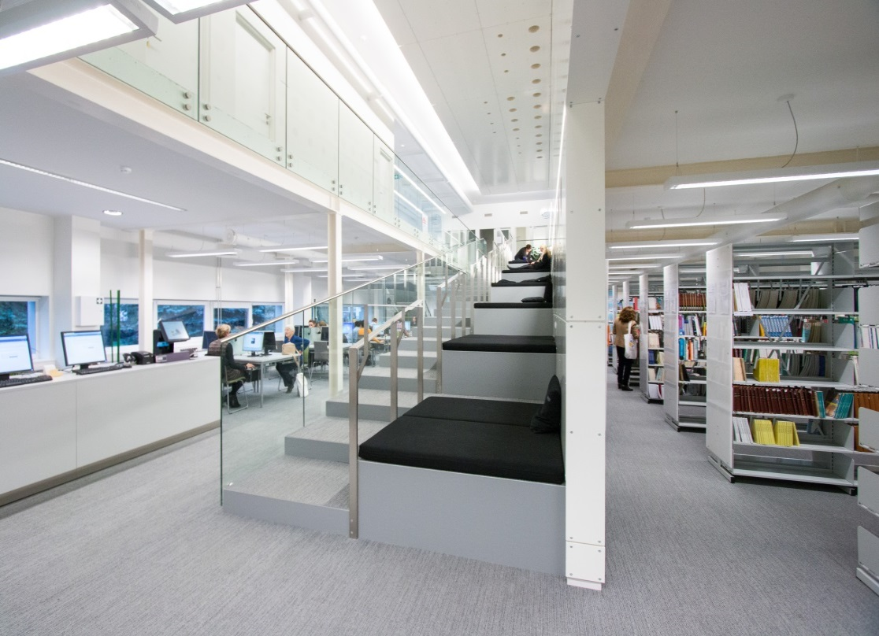
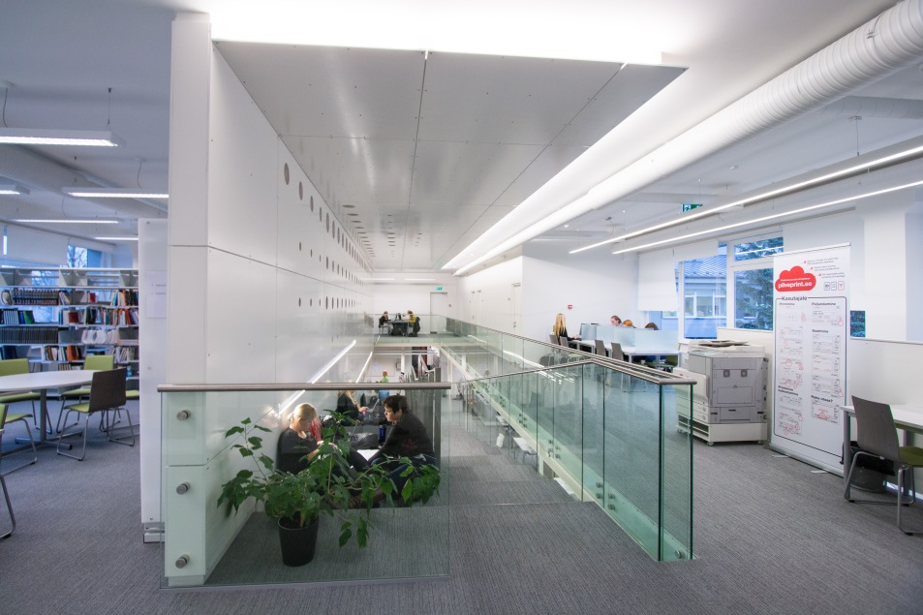
Library
Tallinn Health Care College has a library both in the college building in Tallinn as well as in Kohtla-Järve structural unit
Tallinn Health Care College library is a modern innovative study and research environment
Information resources outside the library are available in the e-Library: catalogues of other libraries, EBSCO databases and electronic professional journals
Individual rooms, group-work rooms, resting zone
Sound system for background music chosen by a musical therapist

Slide 29
Welcome!
Additional information:
Marit Talunik
Marketing and Communications Specialist
marit.talunik@ttk.ee
+372 50 40 729

